Slide 1


Develop enterprise copilot solution using Azure AI Studio
Ashish Sharma
Cloud Solution Architect
Microsoft Azure MVP

Slide 2

Ashish Sharma
Cloud Solution Architect
linkedin.com/in/ashishsharma93/

Slide 3
What is Azure AI Studio?

Slide 4
Azure AI Studio brings together capabilities from Azure Machine Learning, Azure OpenAI service, and other Azure AI services to provide a single, centralized workspace within which developers can collaborate with data scientists and others to build AI solutions..
Notes:
Azure AI Studio is a web portal that brings together multiple Azure AI-related services into a single, unified development environment. Specifically, Azure AI Studio combines:
The model catalog and prompt flow development capabilities of Azure Machine Learning service.
The generative AI model deployment, testing, and custom data integration capabilities of Azure OpenAI service.
Integration with Azure AI Services for speech, vision, language, document intelligence, and content safety.
In this session, we will explore Azure AI Studio and learn how we can use it to create and manage enterprise copilots solution.

Slide 5
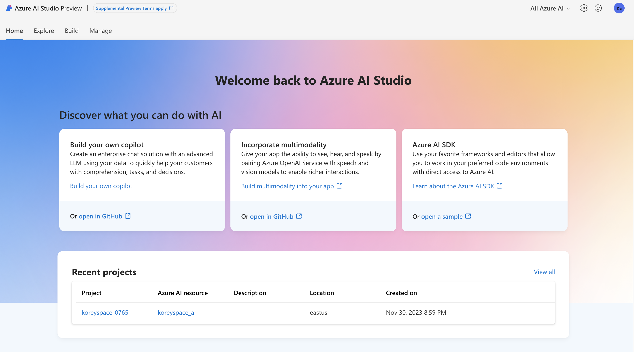
Exploring the Models
Azure AI Studio - https://ai.azure.com

Slide 6
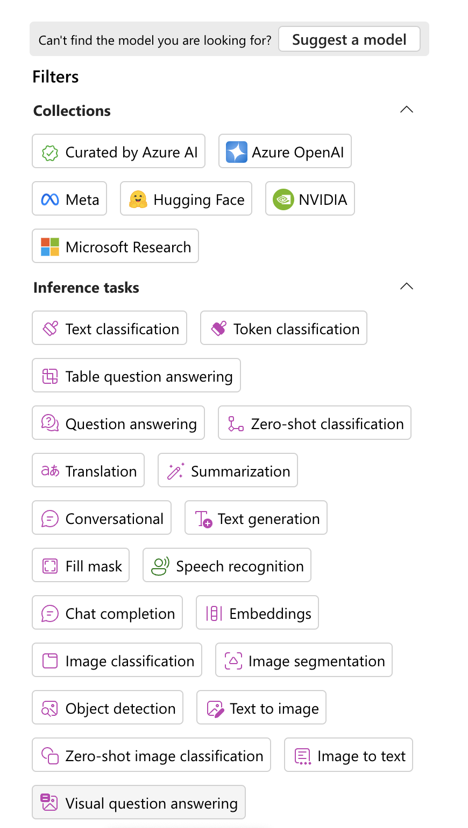
Exploring the Models
Azure AI Studio

Slide 7
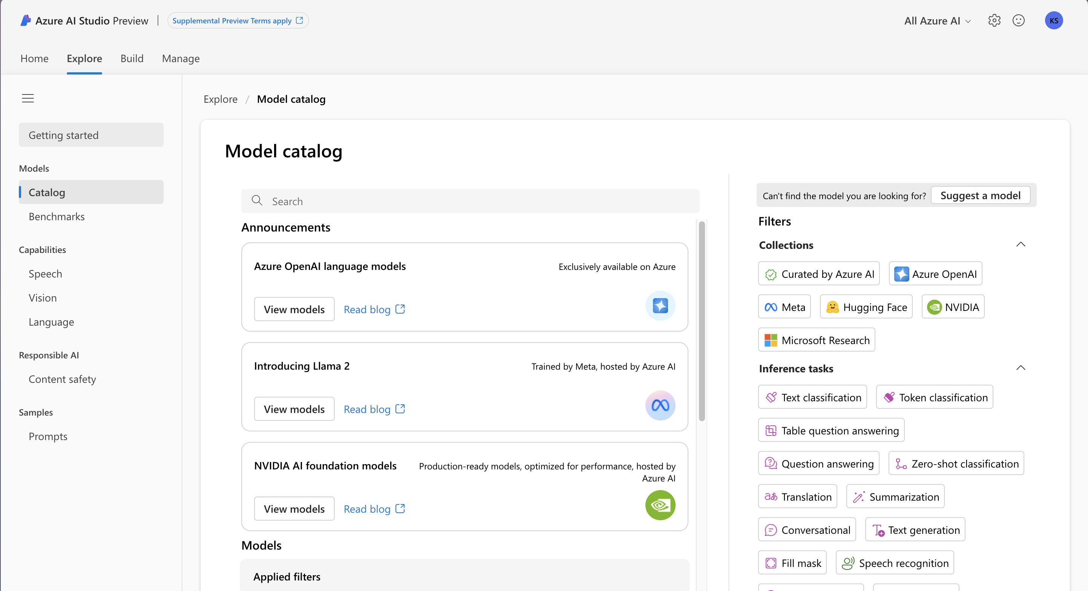
Exploring the Models
Azure AI Studio

Slide 8
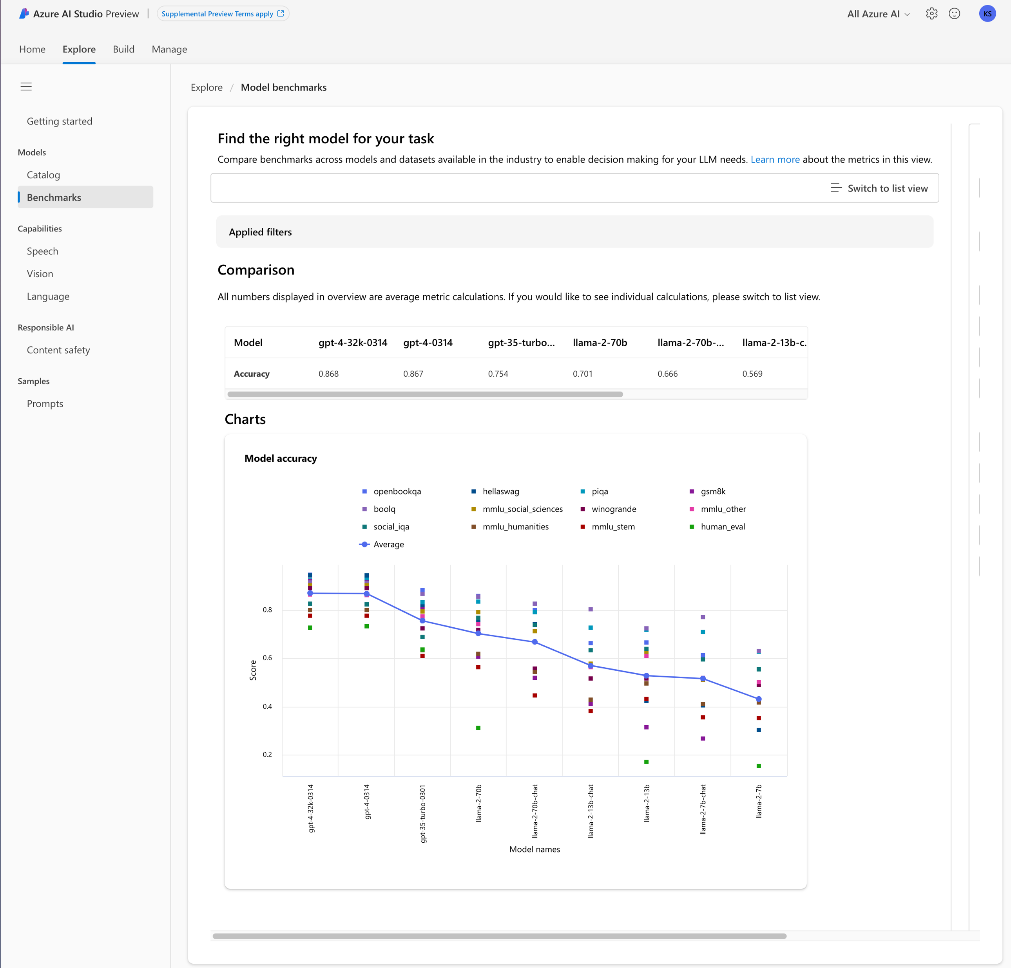
Comparing Models
Azure AI Studio

Slide 9
Azure AI Landing Zone
Notes:
A landing zone in cloud computing provides a well-architected foundation for setting up and managing cloud environments. It encompasses best practices, design principles, and resources that ensure a secure, compliant, and efficient cloud infrastructure. The integration of Azure OpenAI Service into a landing zone enhances these environments with AI capabilities, while maintaining stringent security and governance standards. This integration enables the hosting and implementation of OpenAI models as backend services for applications, enriching the cloud environment with powerful AI capabilities. Businesses can leverage these capabilities to develop innovative applications and services, harnessing the full potential of AI in the cloud.

Slide 10
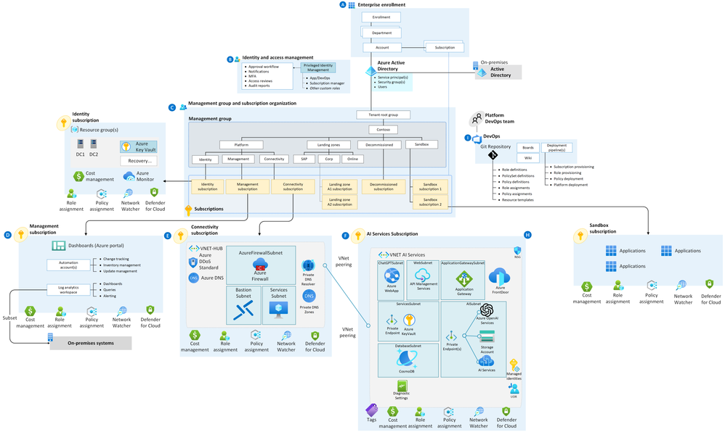

Slide 11
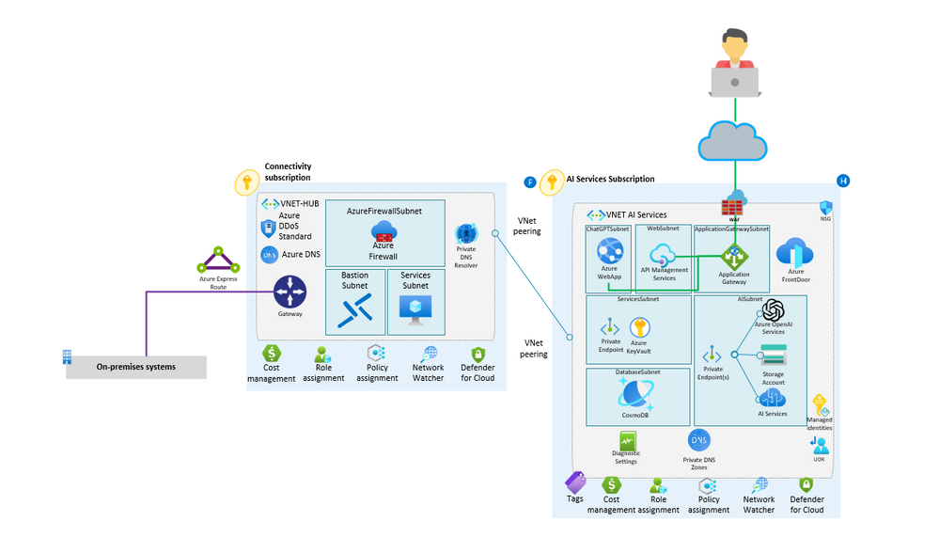

Slide 12
DEMO

